Slide 1
SOC Home Lab for Network Security and Threat Detection
This project focuses on building and configuring a Security Operations Center (SOC) home lab environment to simulate real-world cyber threats, monitor network activity, and generate actionable security telemetry using tools like Sysmon and Splunk. The lab environment includes virtual machines running Windows 10 and Kali Linux, connected via an internal network, to facilitate attack simulations and log analysis.

Slide 2
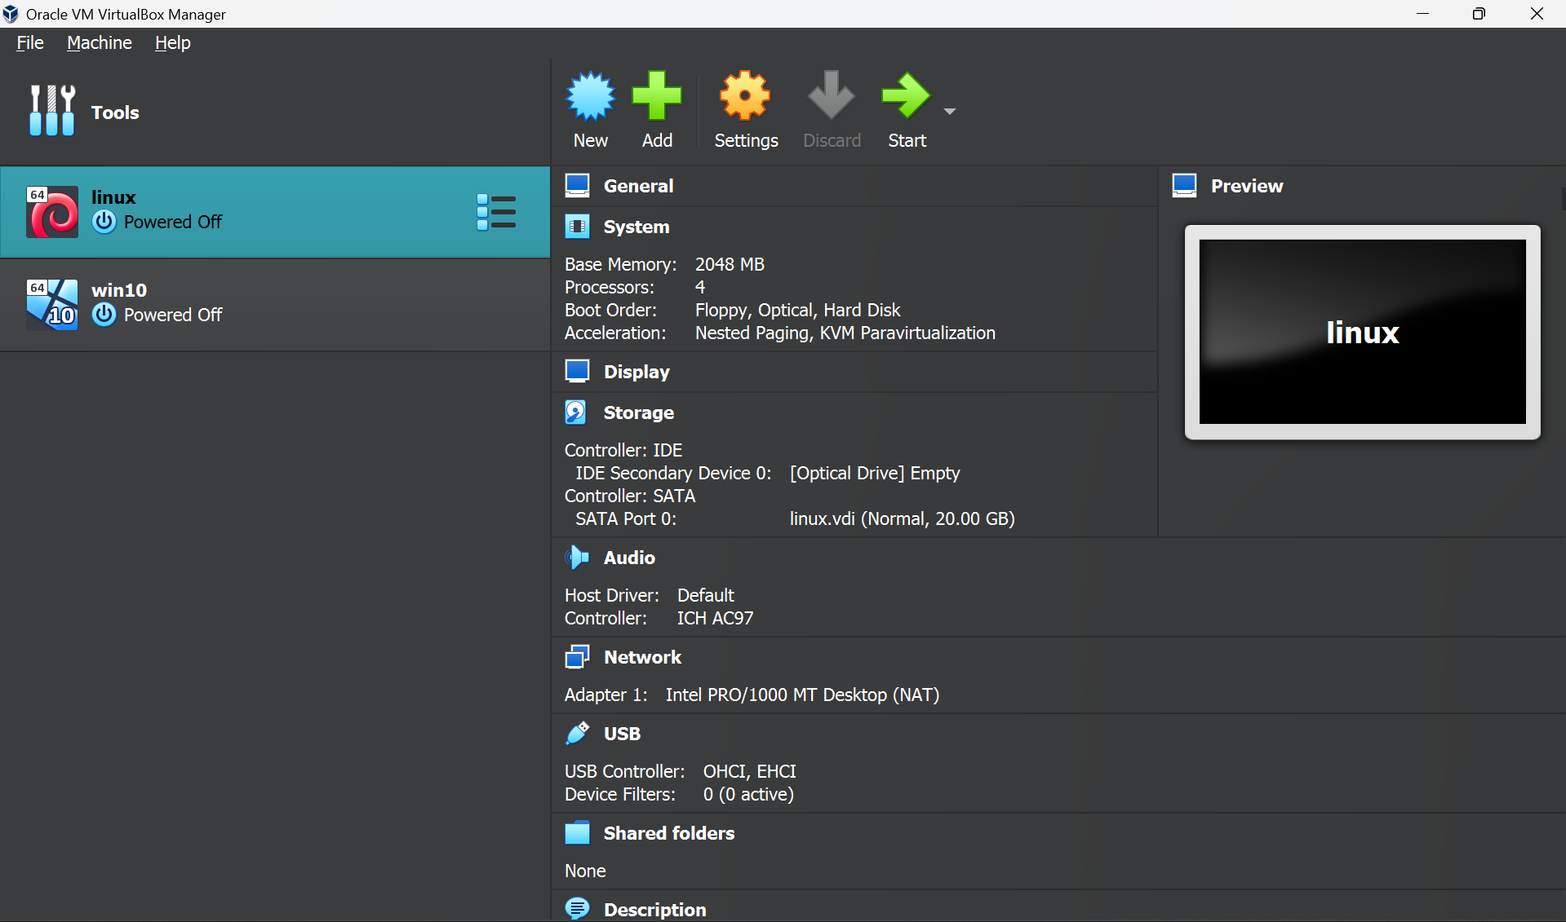
Setting up lab

Slide 3
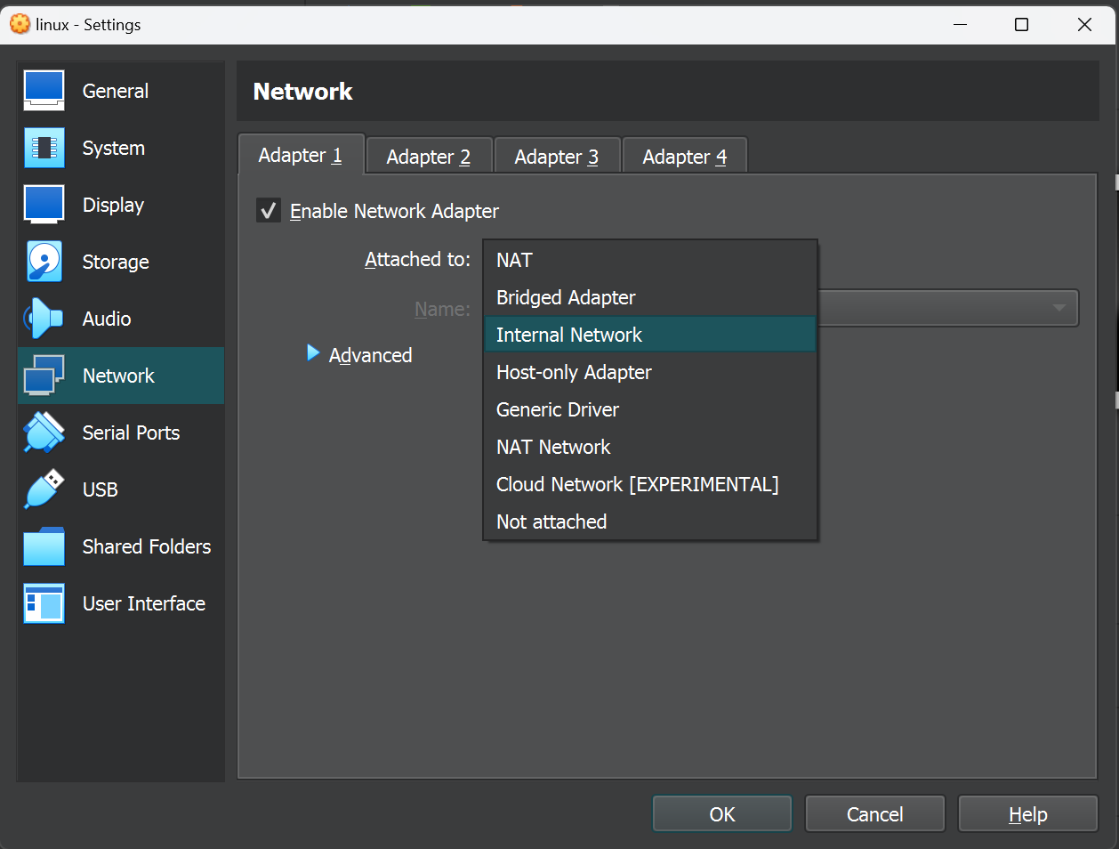
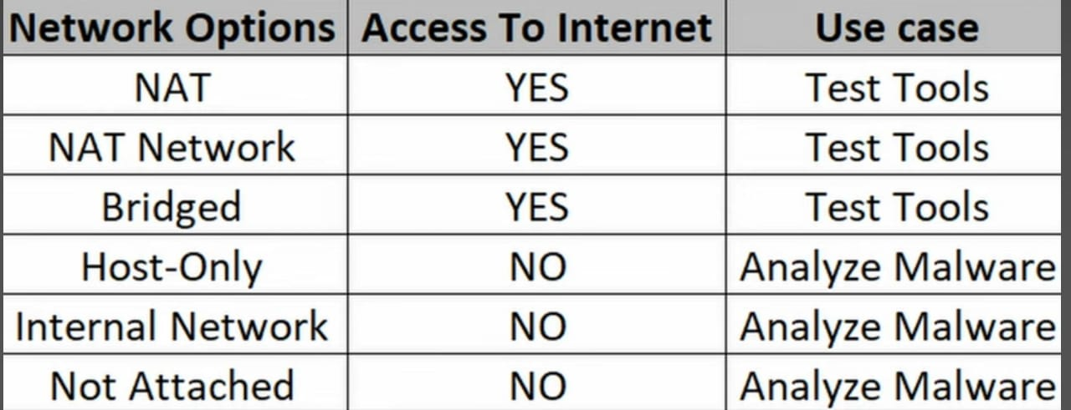
Changing network configurations
Change the Network to Internal network so that the two virtual machines can communicate and out hot network wont get affected

Slide 4
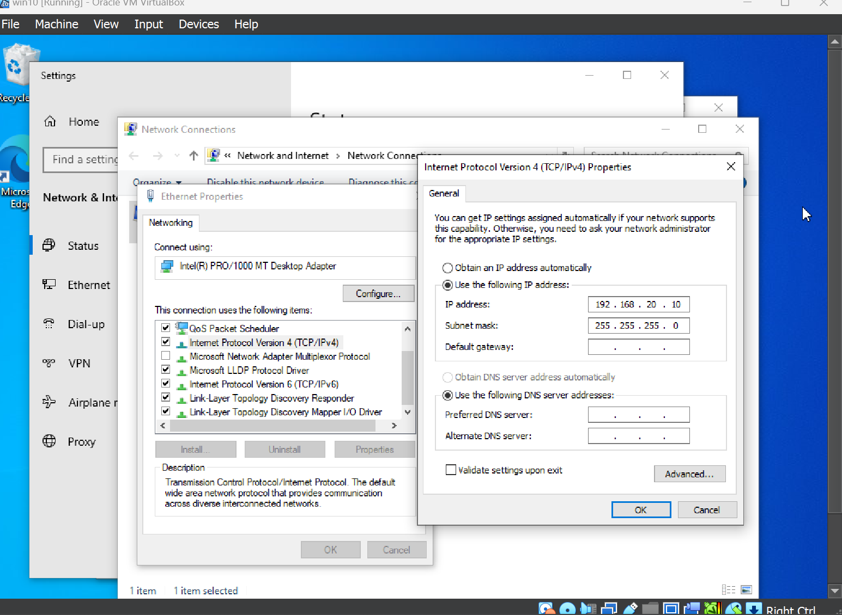
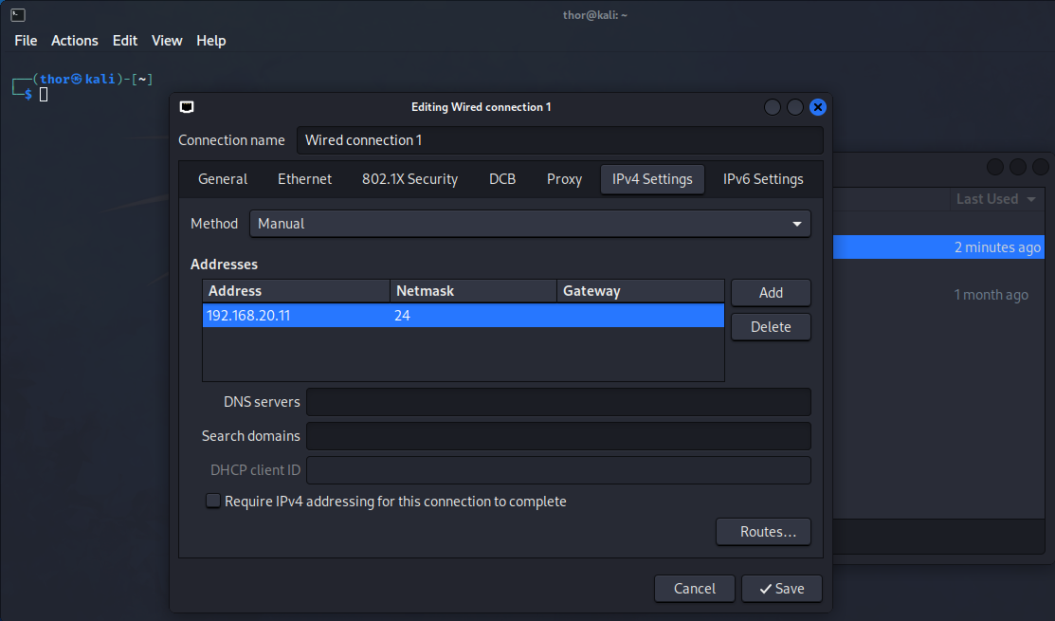
Manually Assigning IP to both Windows, kali

Slide 5
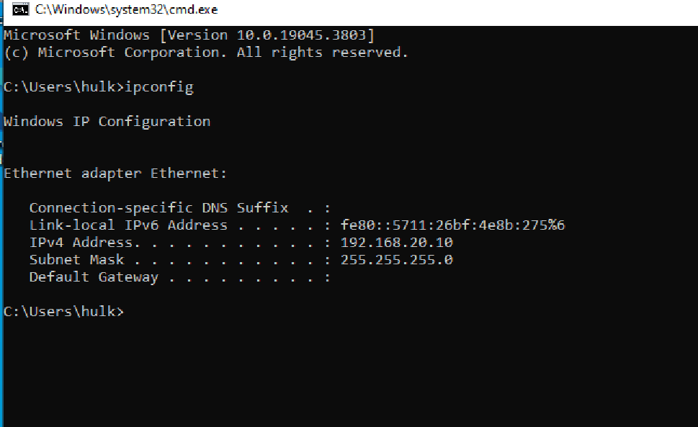
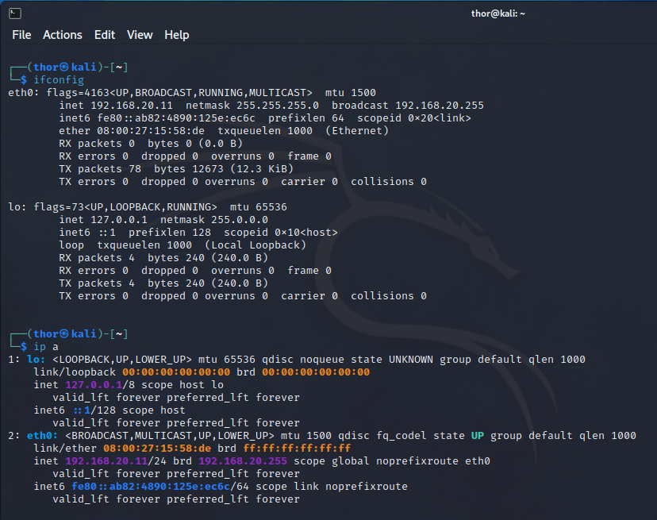
IP assigned to both machine’s

Slide 6
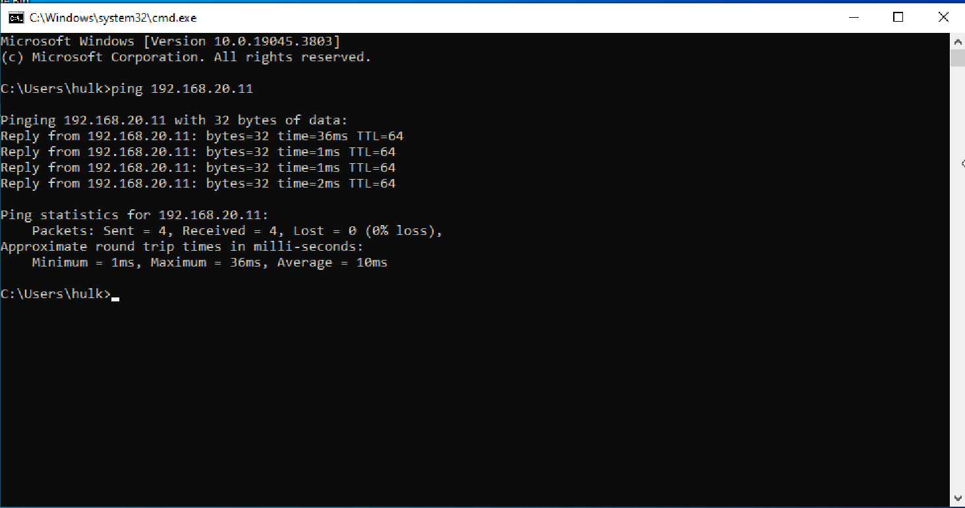
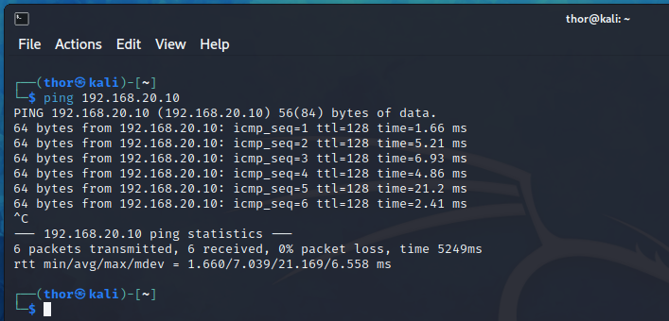
Check Network Connectivity

Slide 7
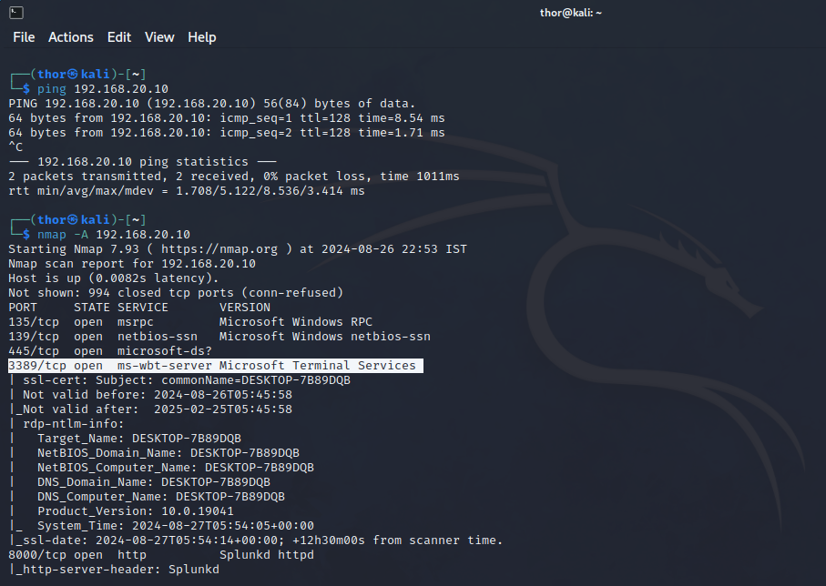
NMAP scan

Slide 8
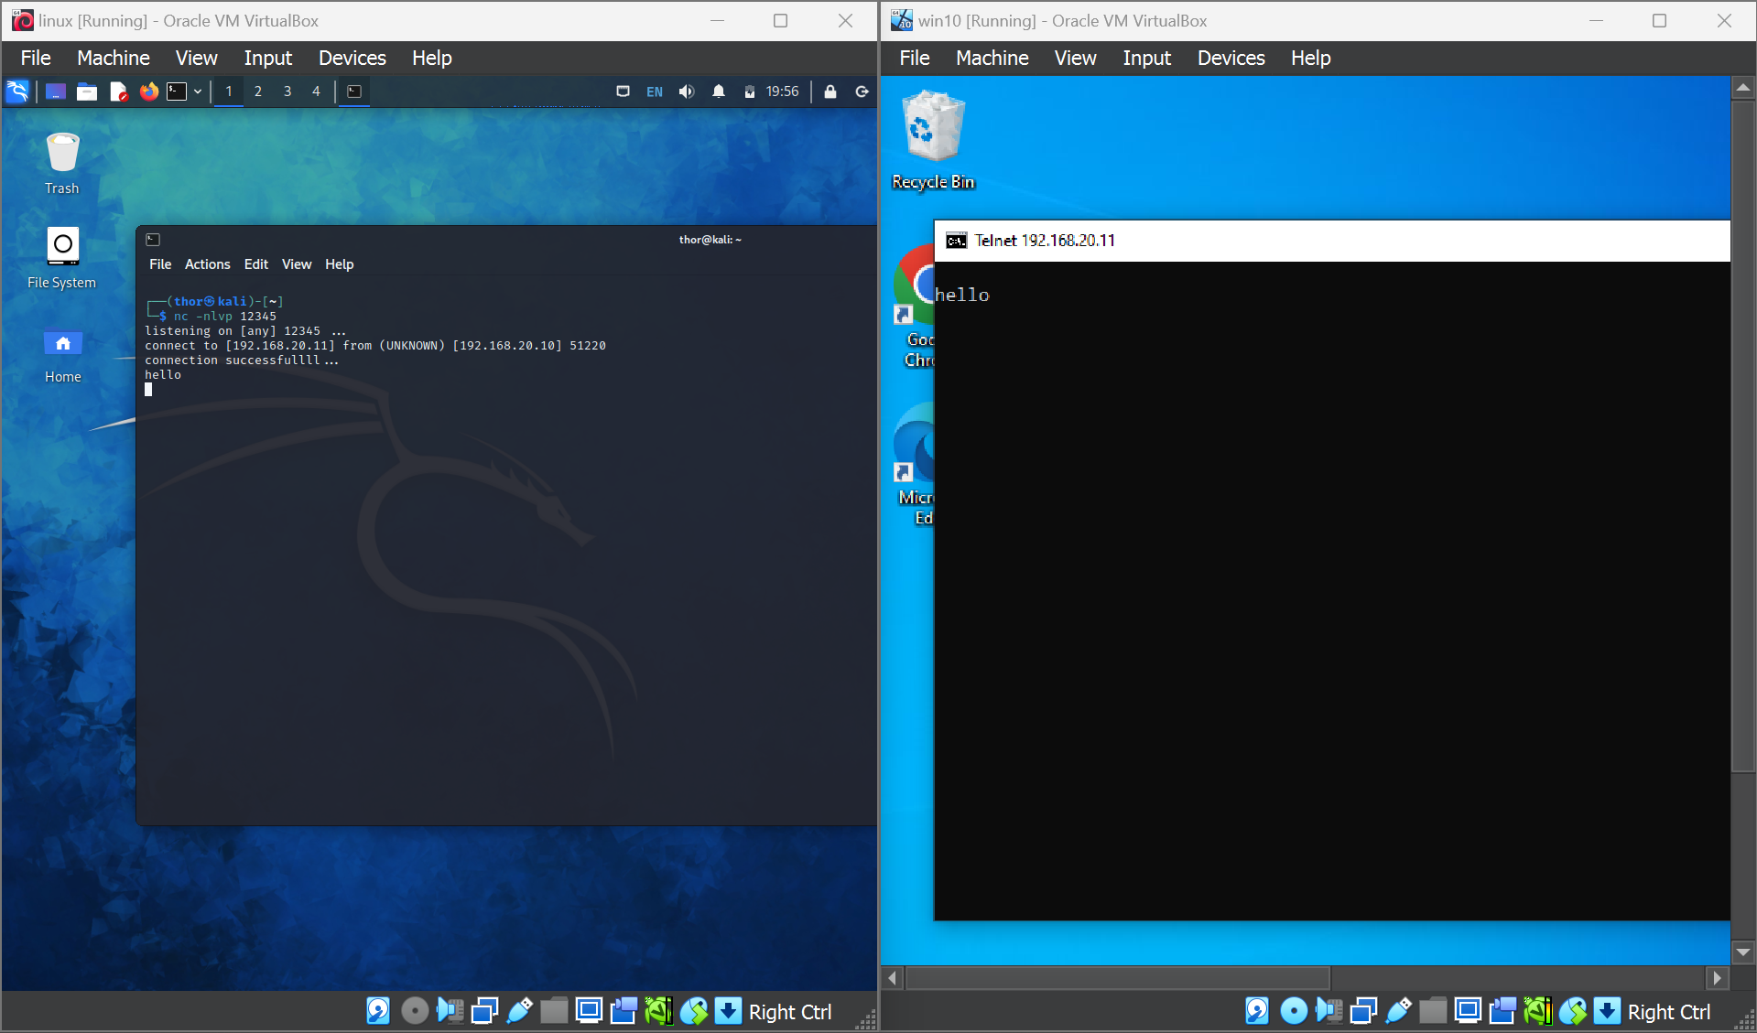
Setting up chat server on windows machine using netcat

Slide 9
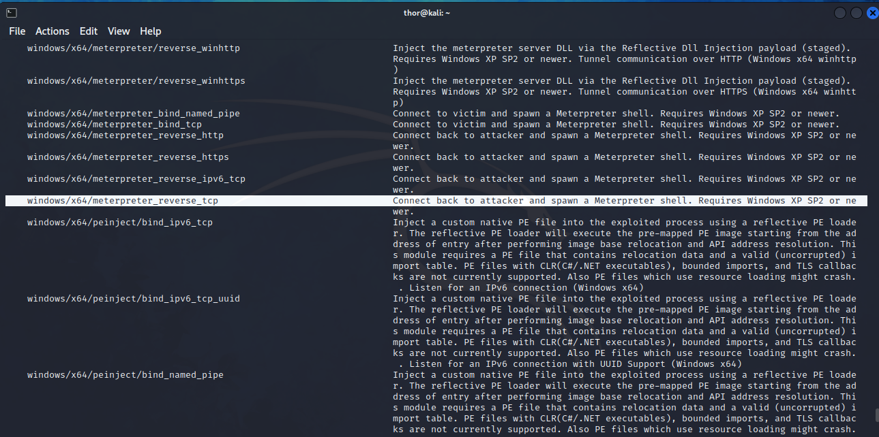
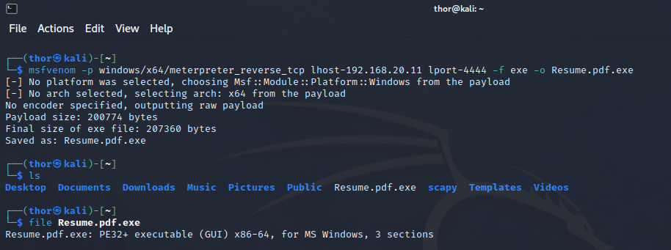
Reverse TCP Payload creation using msfvenom

Slide 10
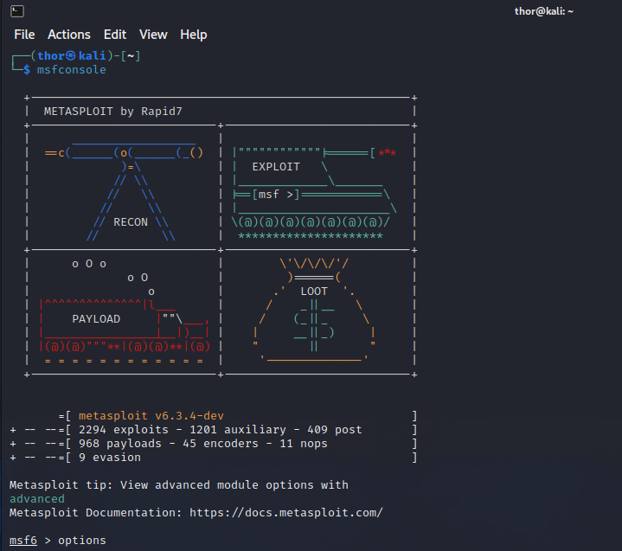
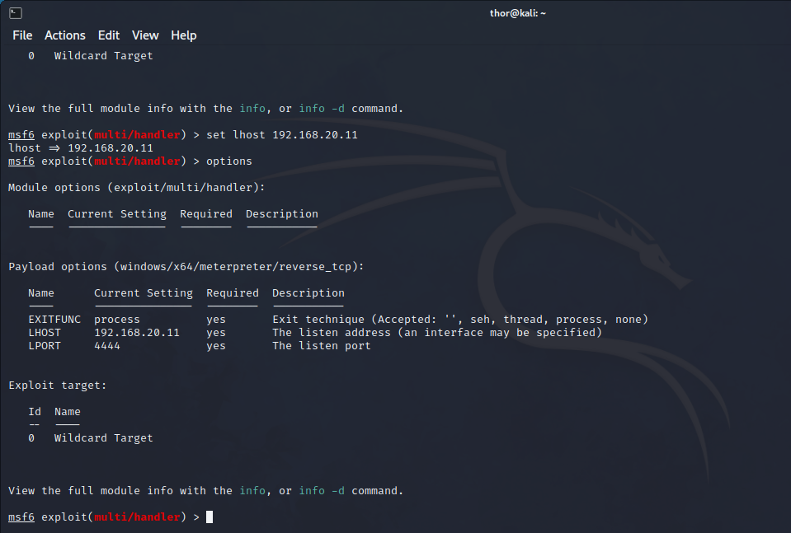
Setting up Listener using msfconsole

Slide 11
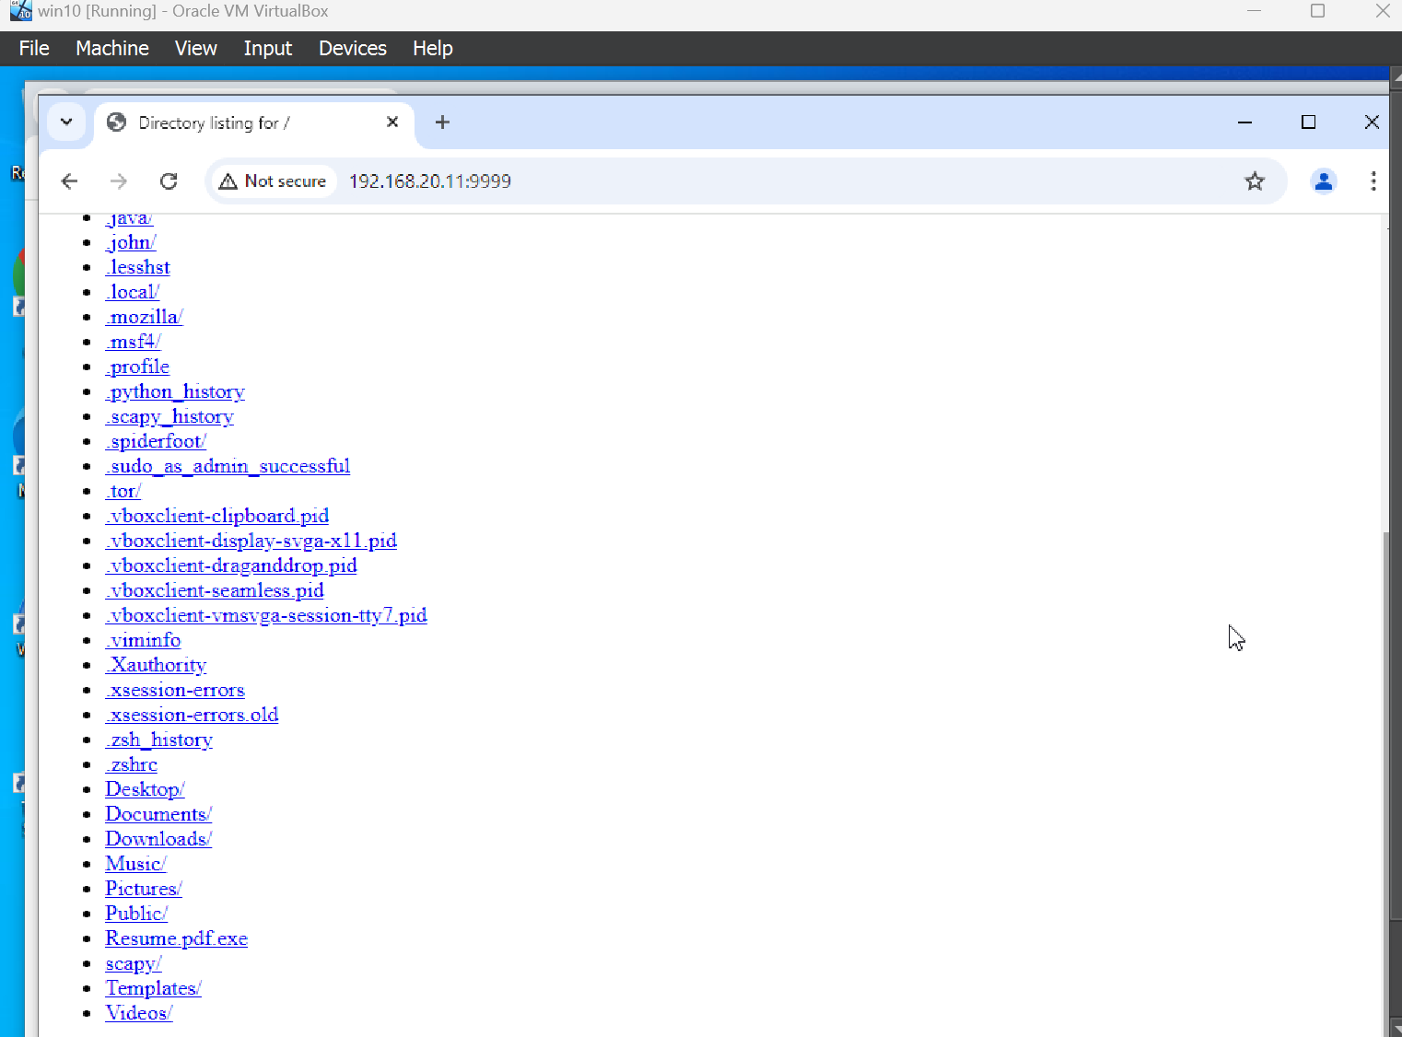
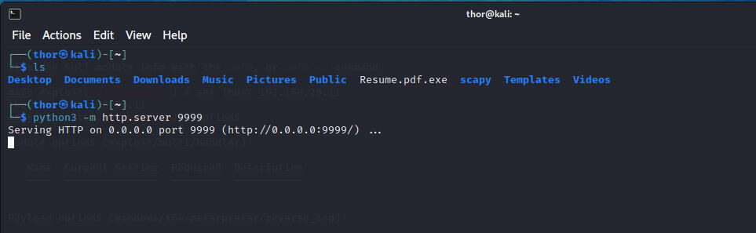
Setting up server and accessing the payload on windows

Slide 12
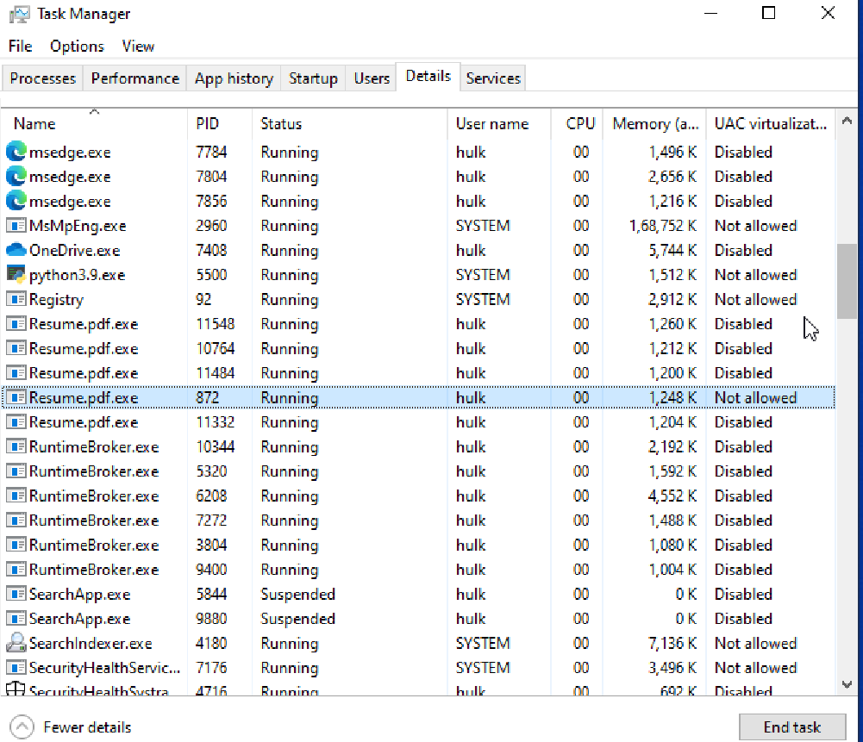
Task manager snapshot

Slide 13
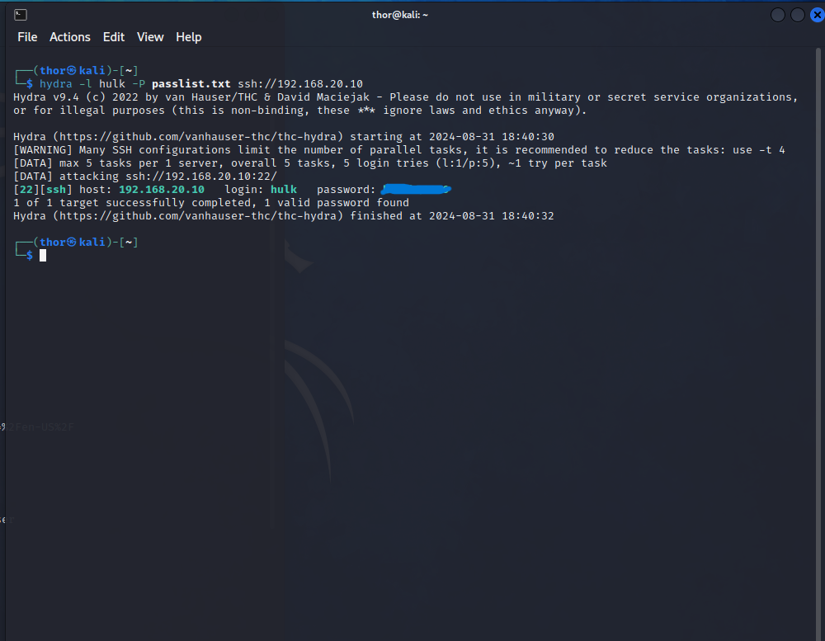
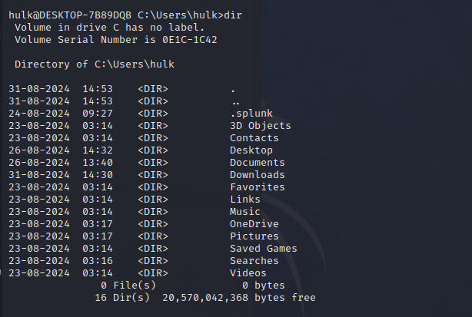
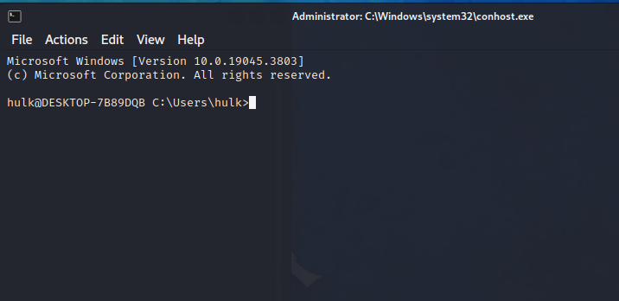
Getting secure shell access

Slide 14
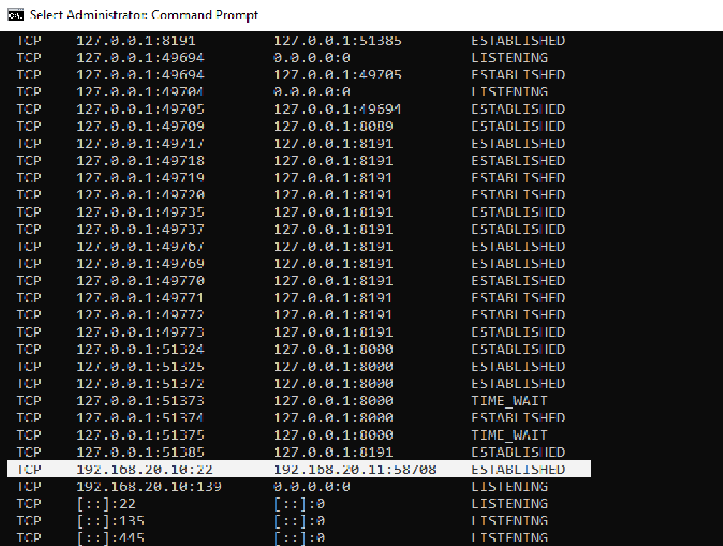
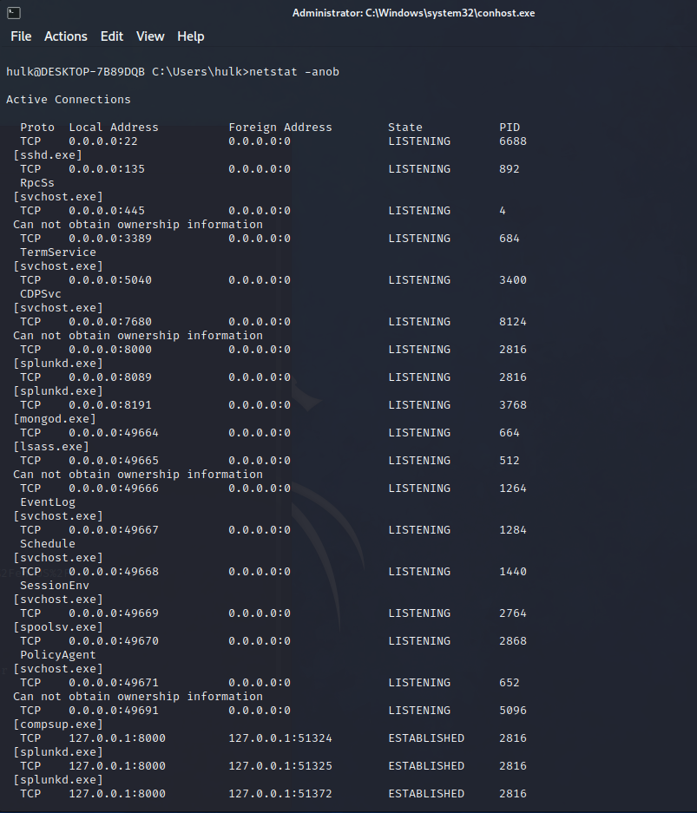
Established connections details using NETSTAT

Slide 15
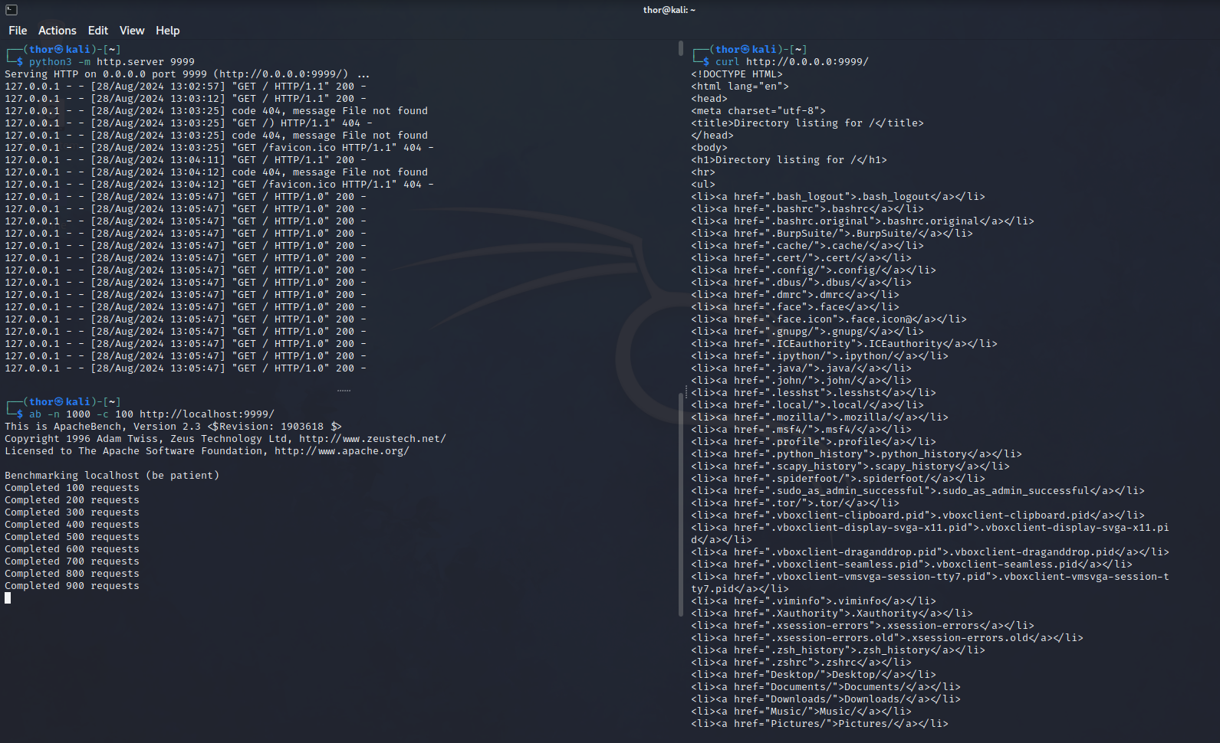
DDOS Attack simulation on server

Slide 16
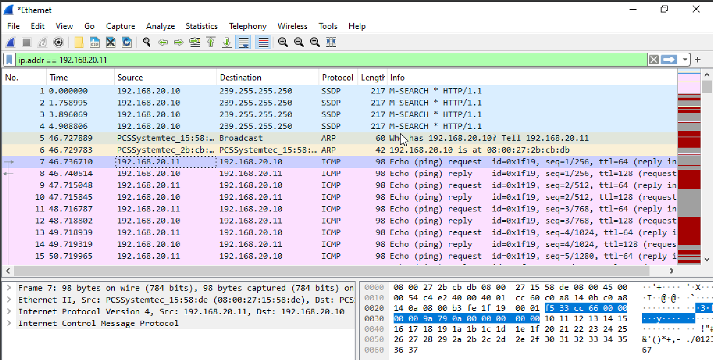
Capturing network traffic on Wireshark

Slide 17
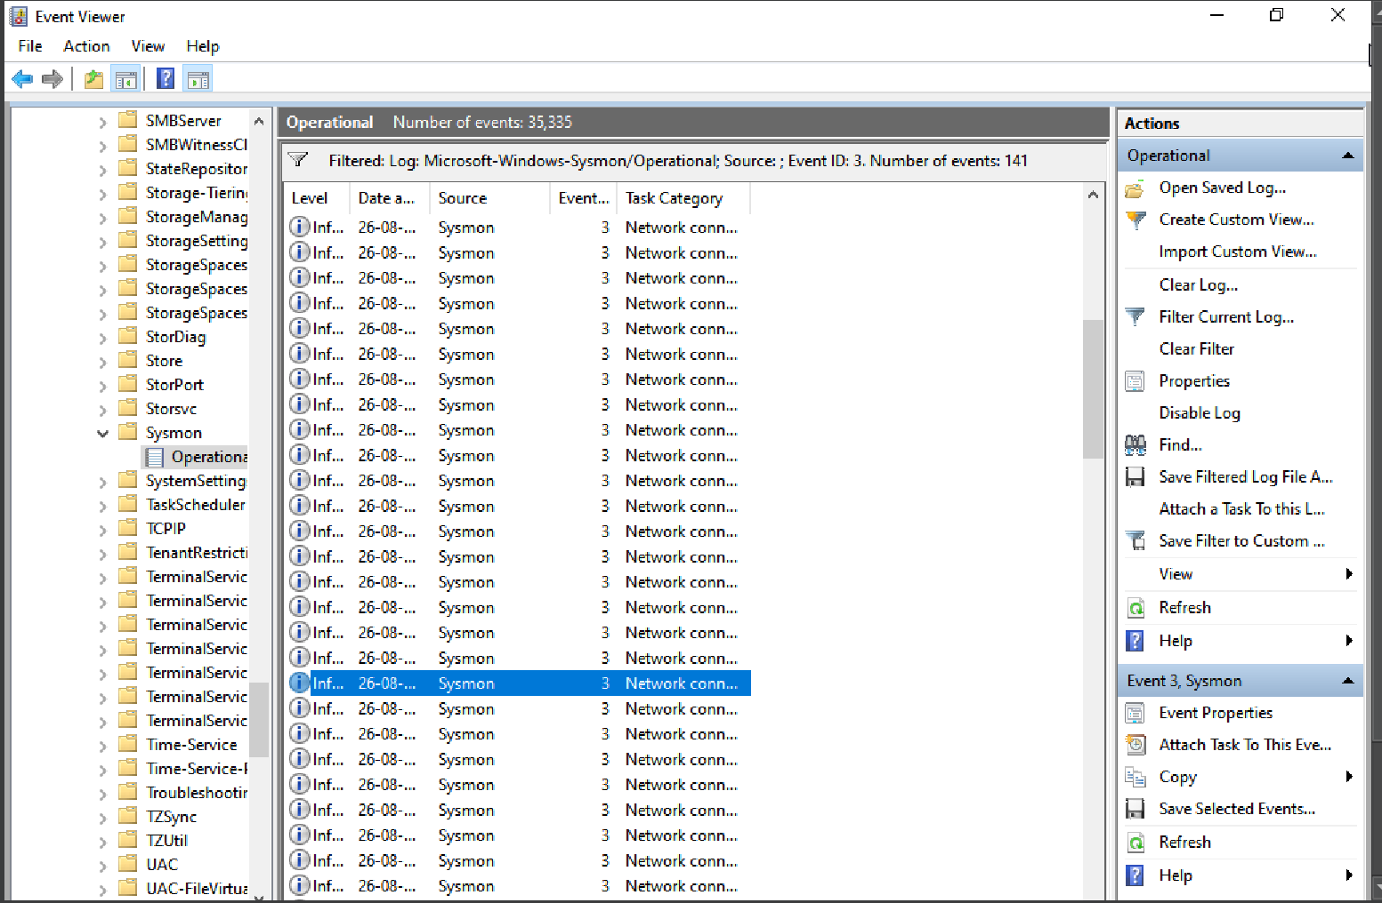
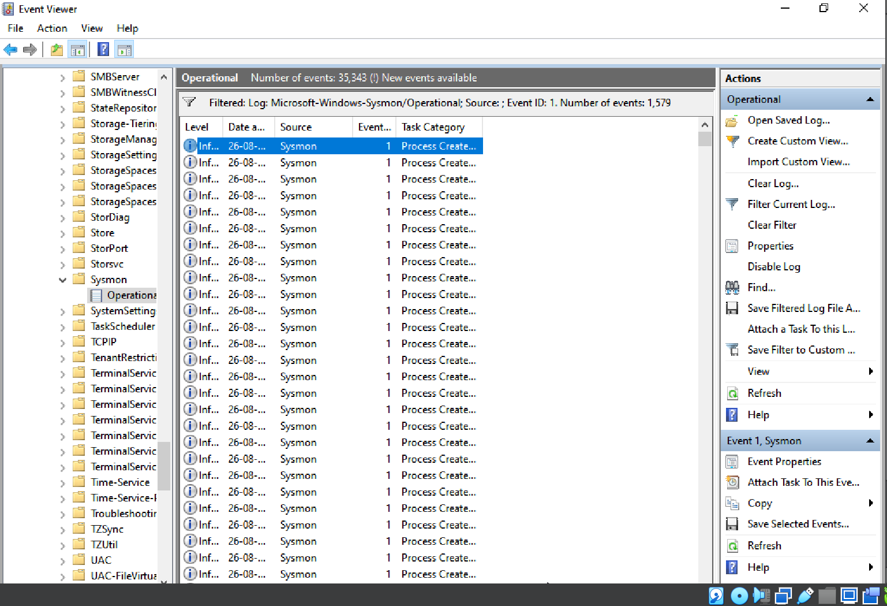
Sysmon Log Analysis
Event ID 3: Network Connection
Event ID 1: Process Creation

Slide 18
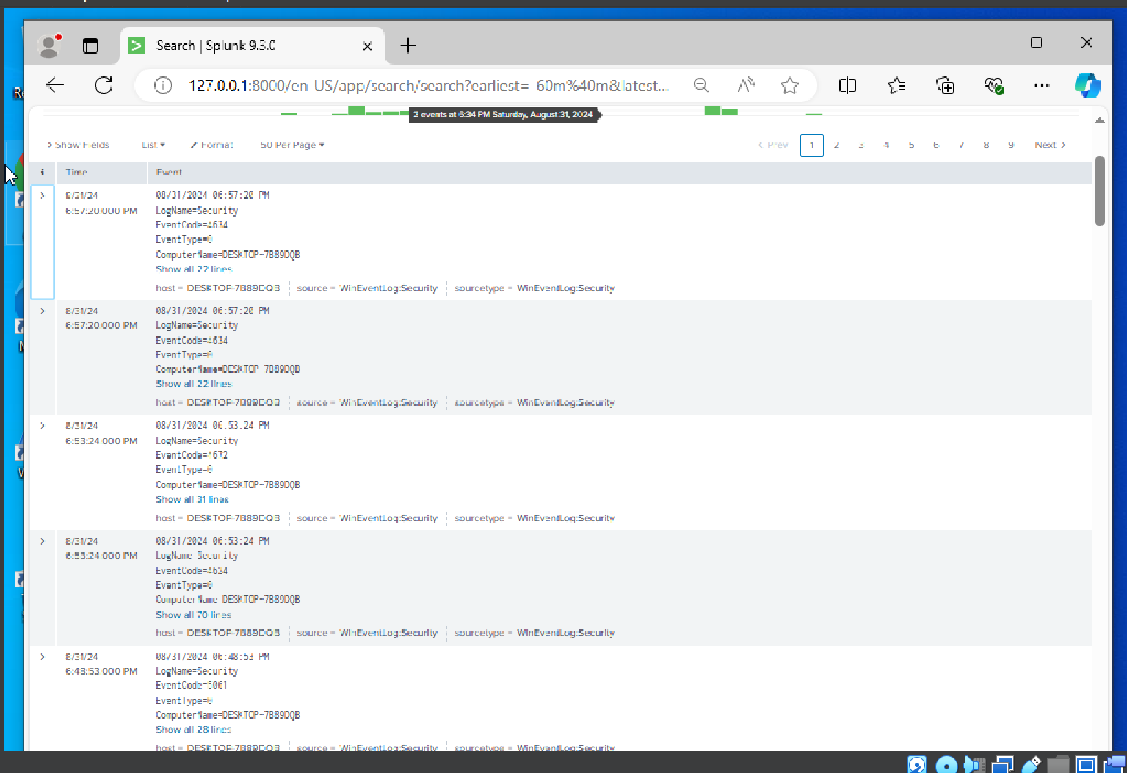
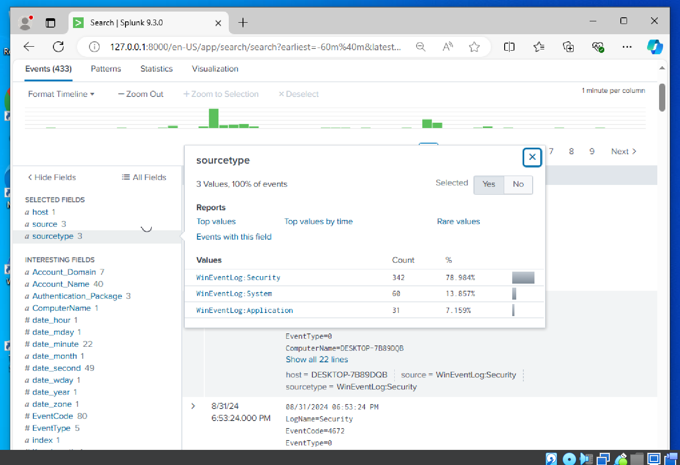
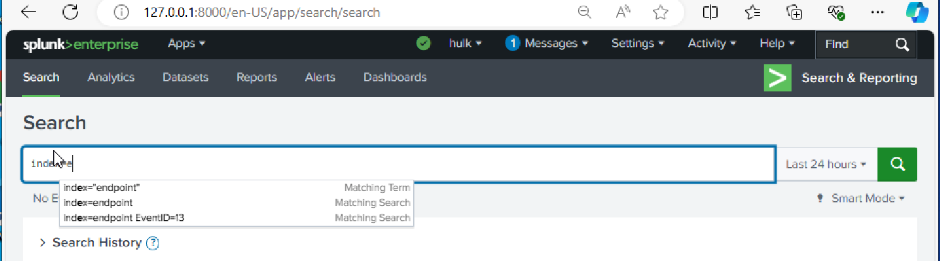
SPLUNK Log analysis

Slide 19
MORE PROJECTS DONE UNDER SOC HOMELAB
Malware analysis lab
Detection and prevention of brute force attacks
port scanner
DDoS attack simulation on server and generating server logs automatically when server is running.

